Slide 1
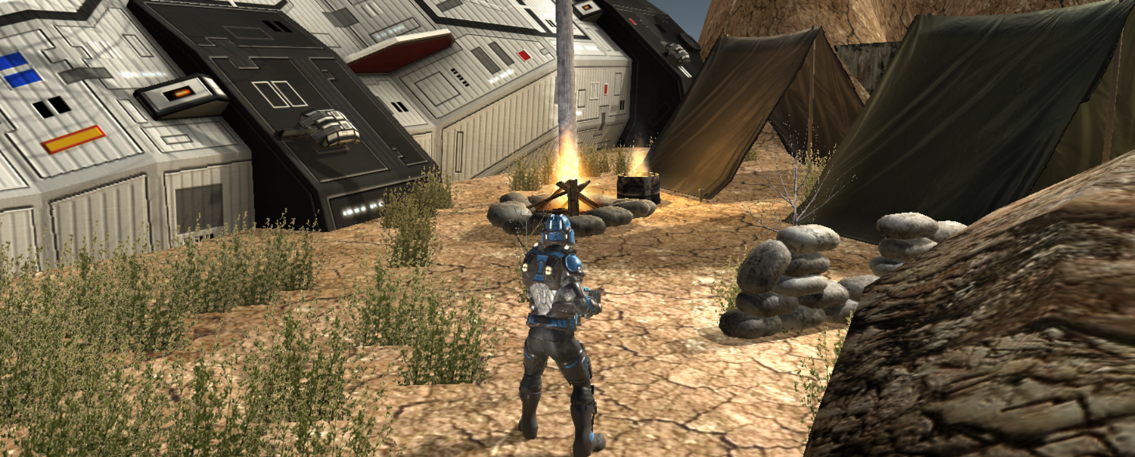
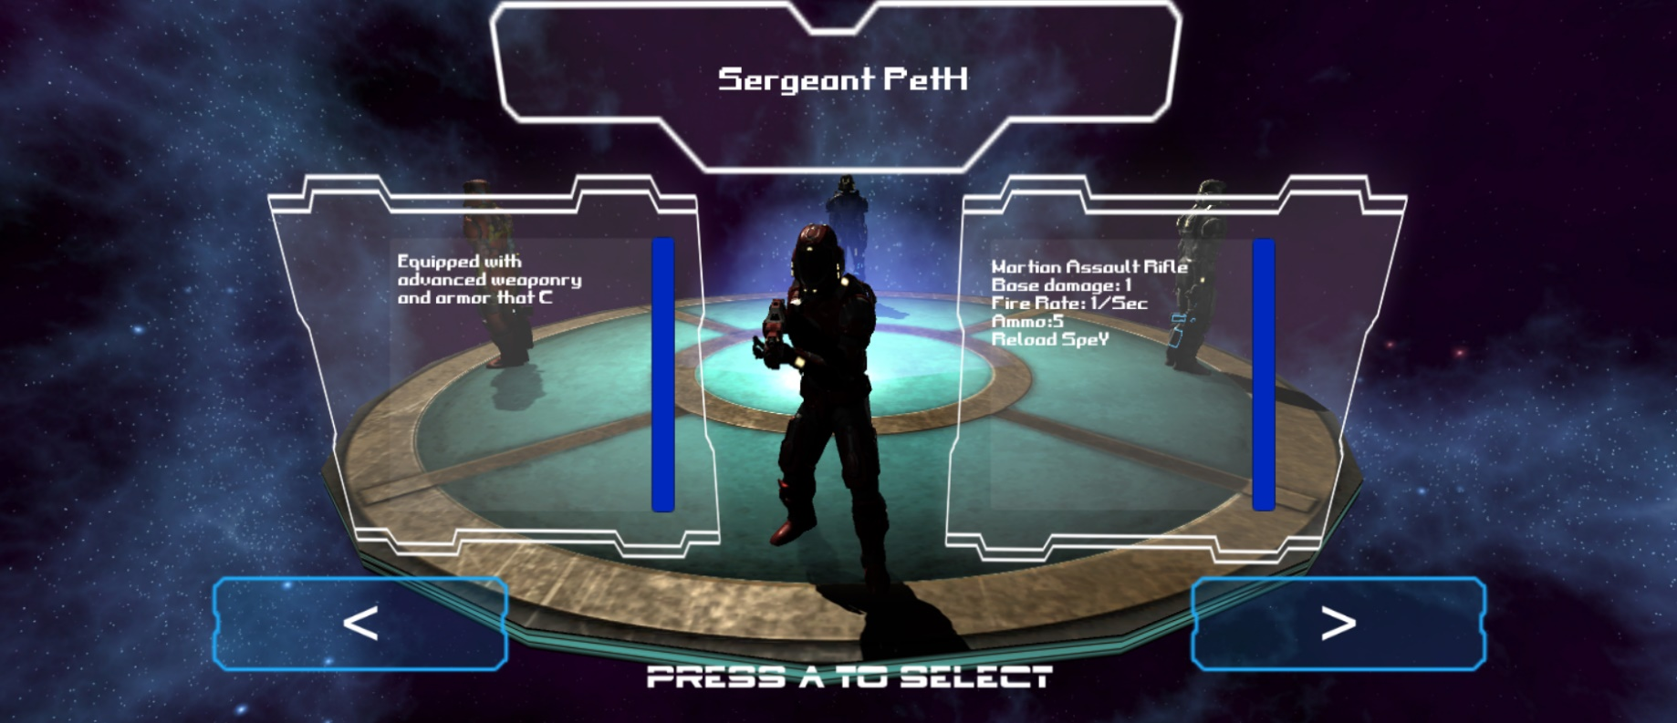
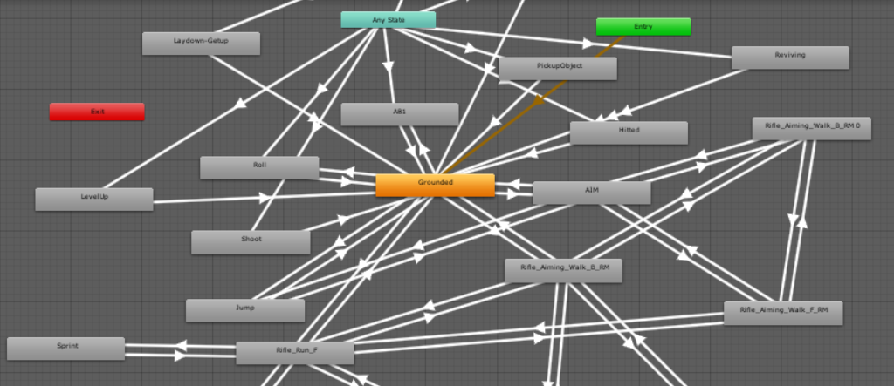
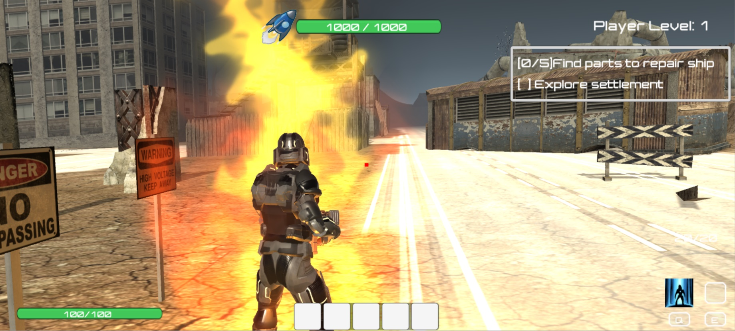
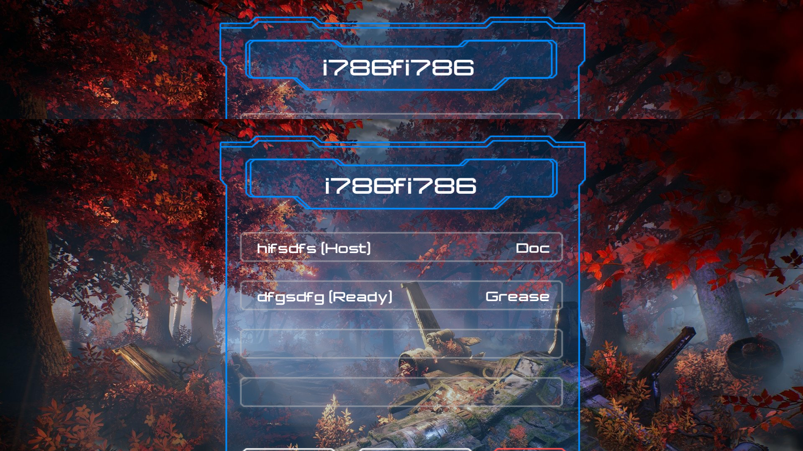
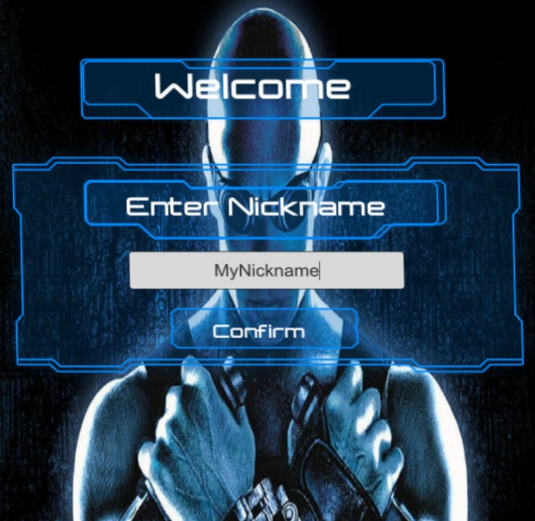
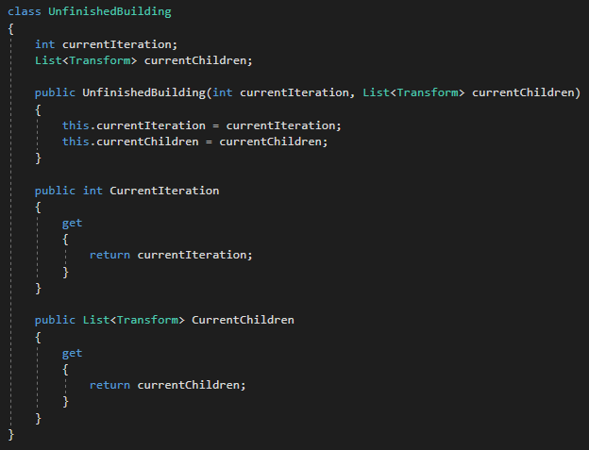
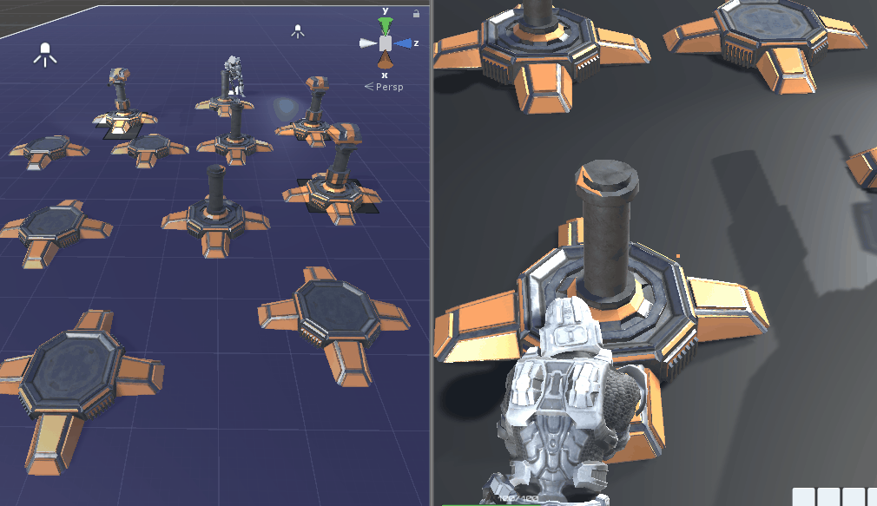
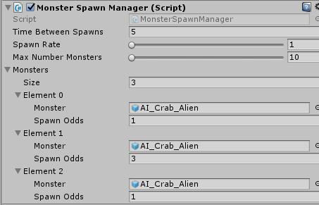
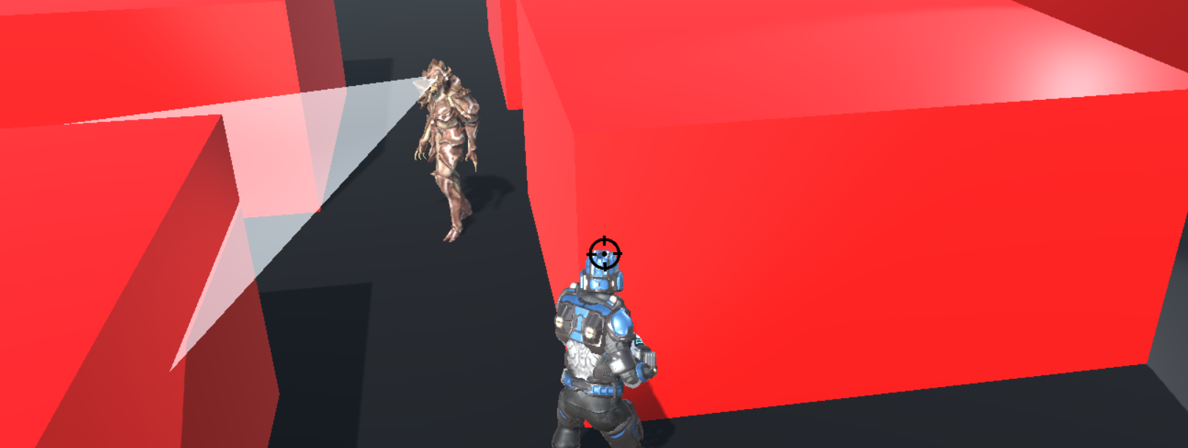
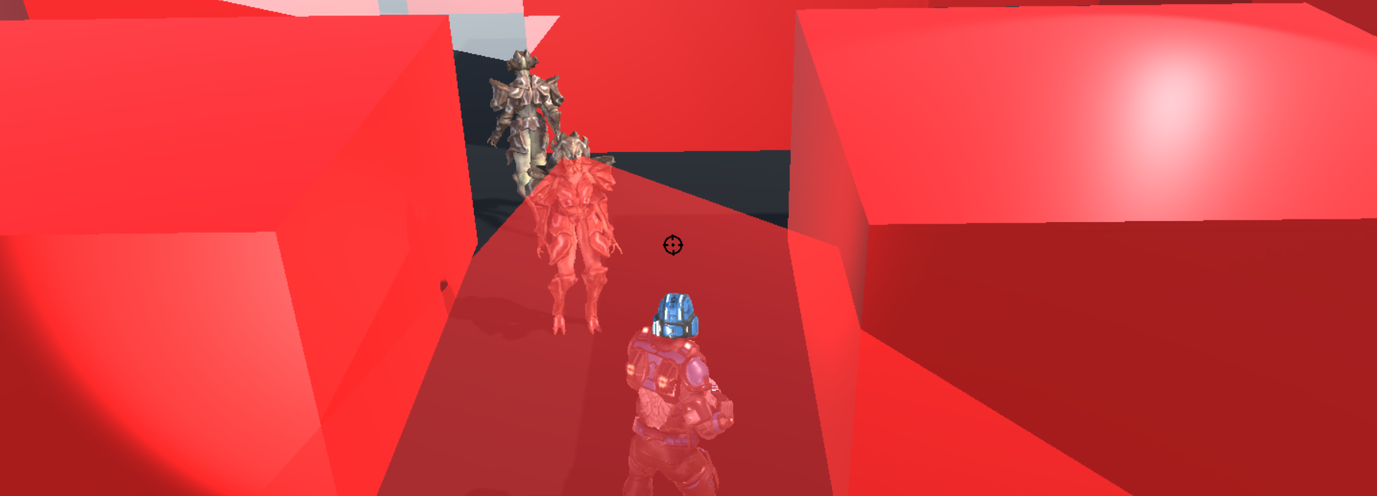
Shipwrecked
Grab your friends and become a legend! Your ship has crash-landed on Earth, which is currently inhabitable and overrun by monsters. Gather up your ship parts spread around the map, while fending off these monsters just to escape alive!
Gameplay
Play with up to 3 others
Additional single-player challenge mode
Large level to explore
Characters
Choose from four different characters
Unique gun, voice and special abilities for each character
All characters have animation controller with multiple animations
Gain experience by killing enemies, allowing upgrades
Networking
Networking capabilities were developed using Photon
Lobby system
Greatly reduced lag by extrapolating player movement vs. interpolating player movement
Turrets
Mechanic can build turrets with shooting capabilities + AI FOV
Mechanic can build incomplete turret, stop, and come back and finish building turret
Spawning
Implemented with spawn managers
The spawn odds of each monster determines the probability of it spawning, where the probability is SpawnOdds /TotalOdds.
Adaptive AI
Used A* Pathfinding Project
Includes navmesh graph, a grid graph, and a point graph representation for the A* algorithm to traverse
Implements both object avoidance when attacking the player and waypoint traversal when attacking the base.
Field of View implemented for monsters and turrets
After issues with AI not detecting target since FOV only targeted center of targets, updated to allow FOV to see extents of target

